Slide 1

WIPRO NGA Program – Data Center Batch 9
Capstone Project Presentation –29 Aug 2025
Project Title Here - Appointment Booking with Doctor Application
Presented by - Soham Rath | userId- 30698
www.rpsconsulting.in

Slide 2

Introduction
Web-based Doctor Appointment Booking System
Built with Spring Boot (backend) and Angular (frontend)
Database: MySQL (persistent storage)
Authentication & security with JWT
Supports 3 user roles: Patient, Doctor, Admin
Containerized using Docker and deployed on Kubernetes (Minikube)
2
2025 - RPS Consulting all rights reserved

Slide 3
ER Diagram
ER DIAGRAM DOCTOR APPOINTMENT APPLICATION_ WEB VIEW
3
2025 - RPS Consulting all rights reserved

Slide 4
Class Diagram
CLASS DIAGRAM DOCTOR APPOINTMENT APPLICATION_ WEB VIEW
4
2025 - RPS Consulting all rights reserved

Slide 5
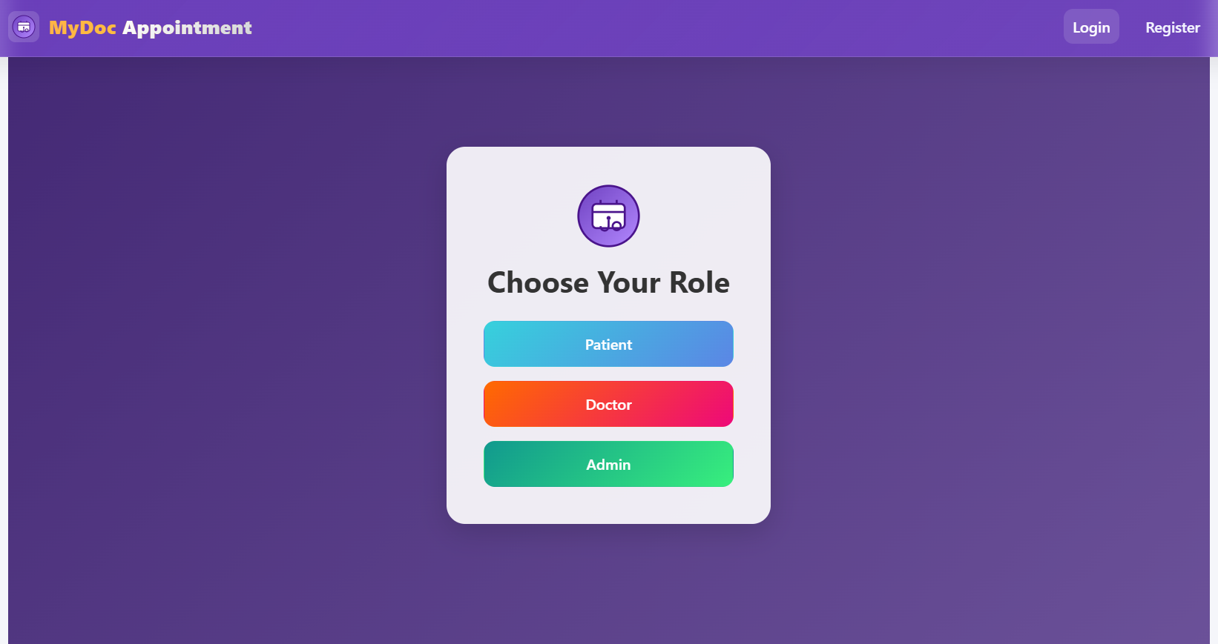
ROLE PAGE
5
2025 - RPS Consulting all rights reserved

Slide 6
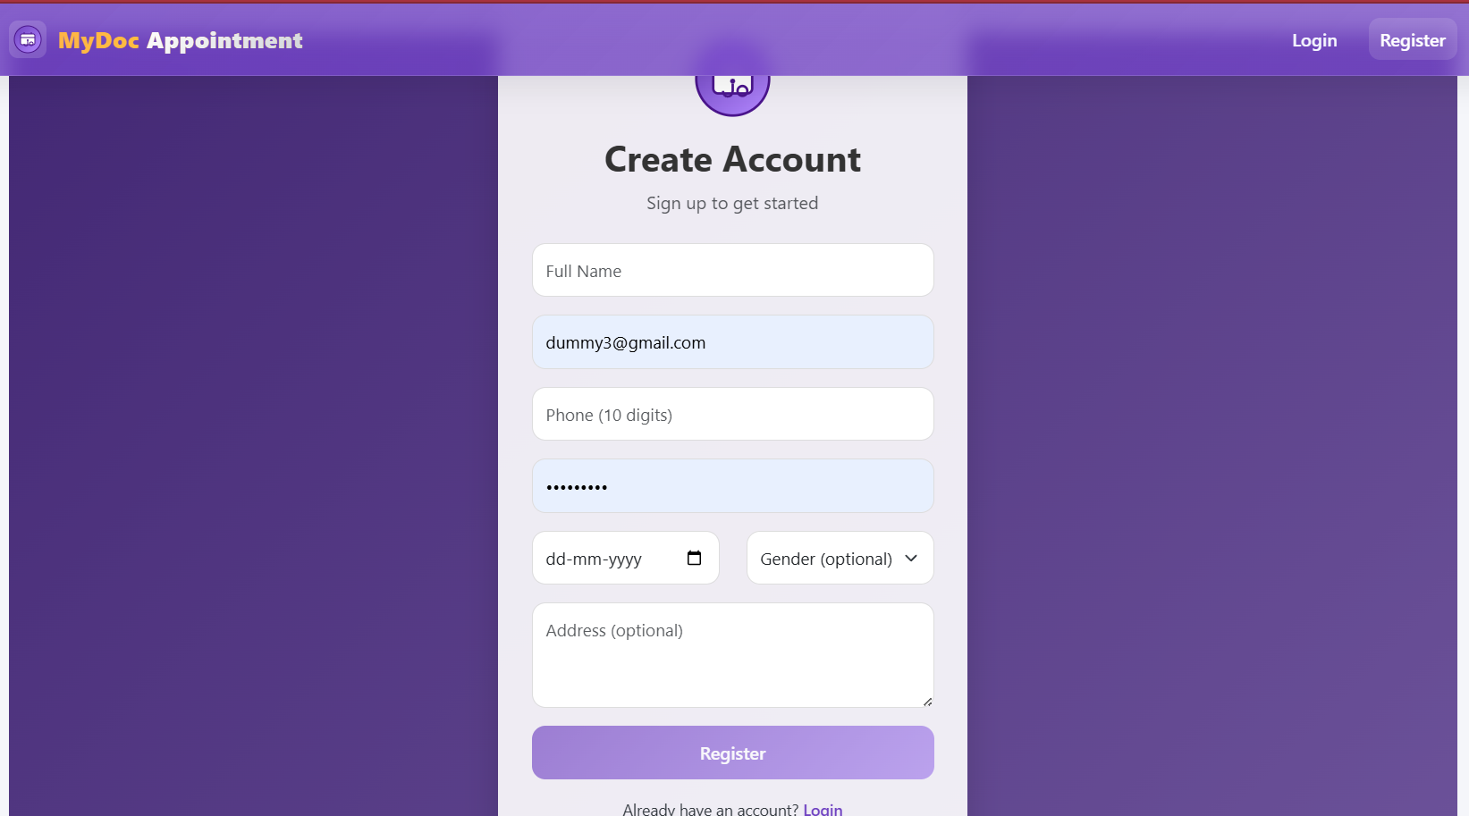
REGISTRATION PAGE
6
2025 - RPS Consulting all rights reserved

Slide 7
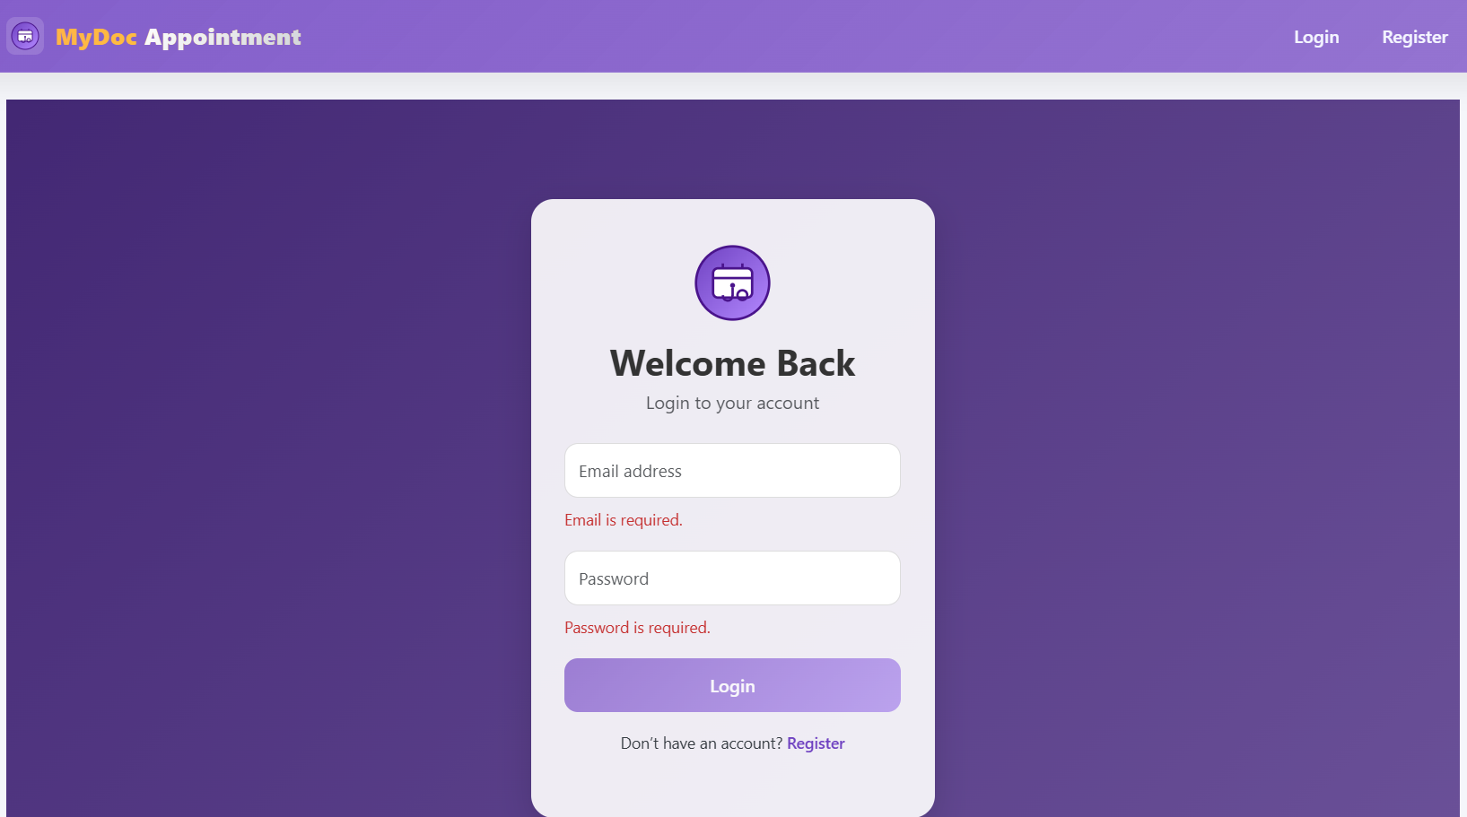
LOG-IN SCREEN
7
2025 - RPS Consulting all rights reserved

Slide 8
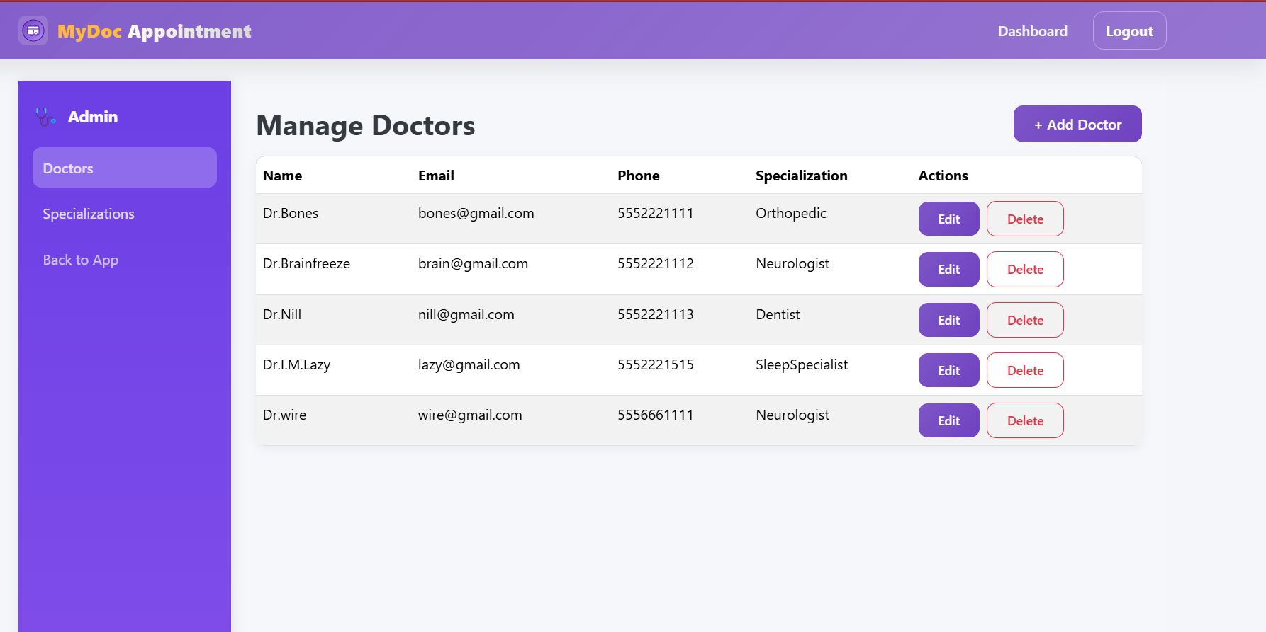
ADMIN DASHBOARD
8
2025 - RPS Consulting all rights reserved

Slide 9
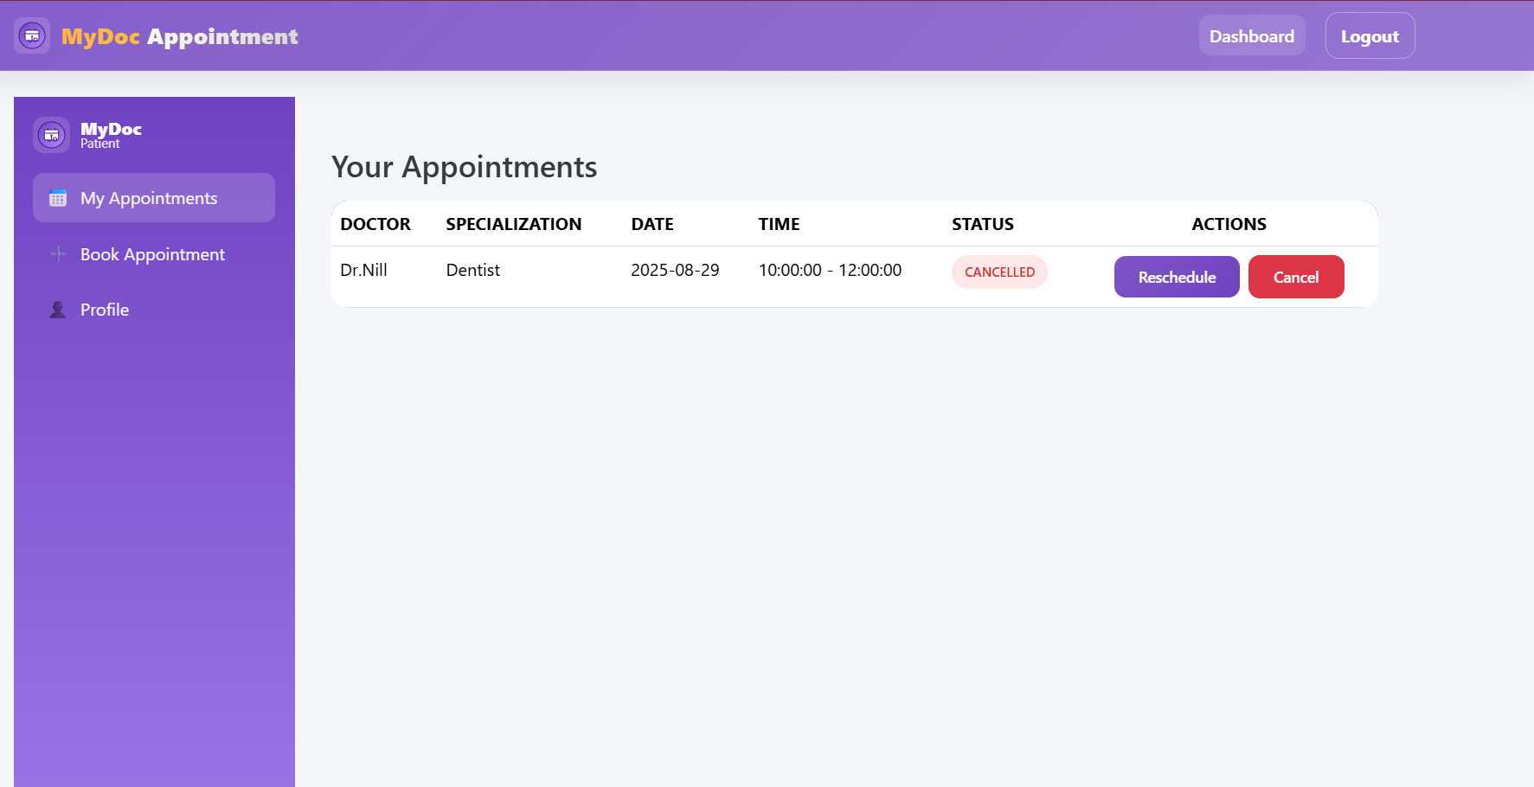
PATIENT DASHBOARD
9
2025 - RPS Consulting all rights reserved

Slide 10
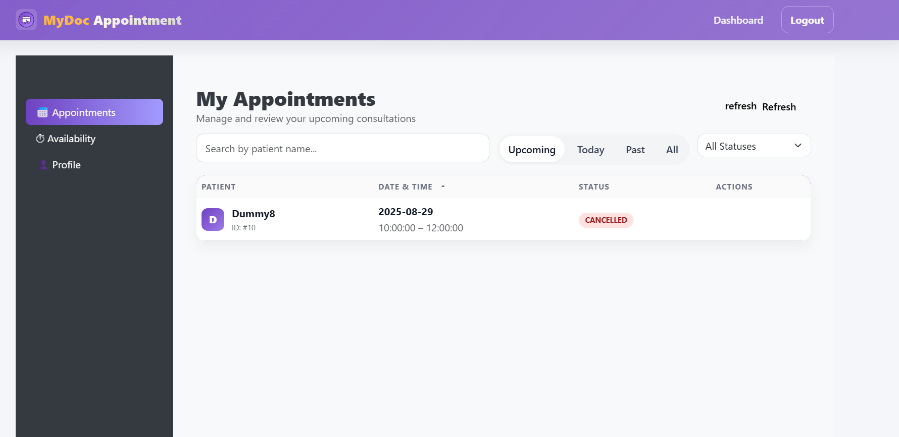
DOCTOR DASHBOARD
10
2025 - RPS Consulting all rights reserved

Slide 11
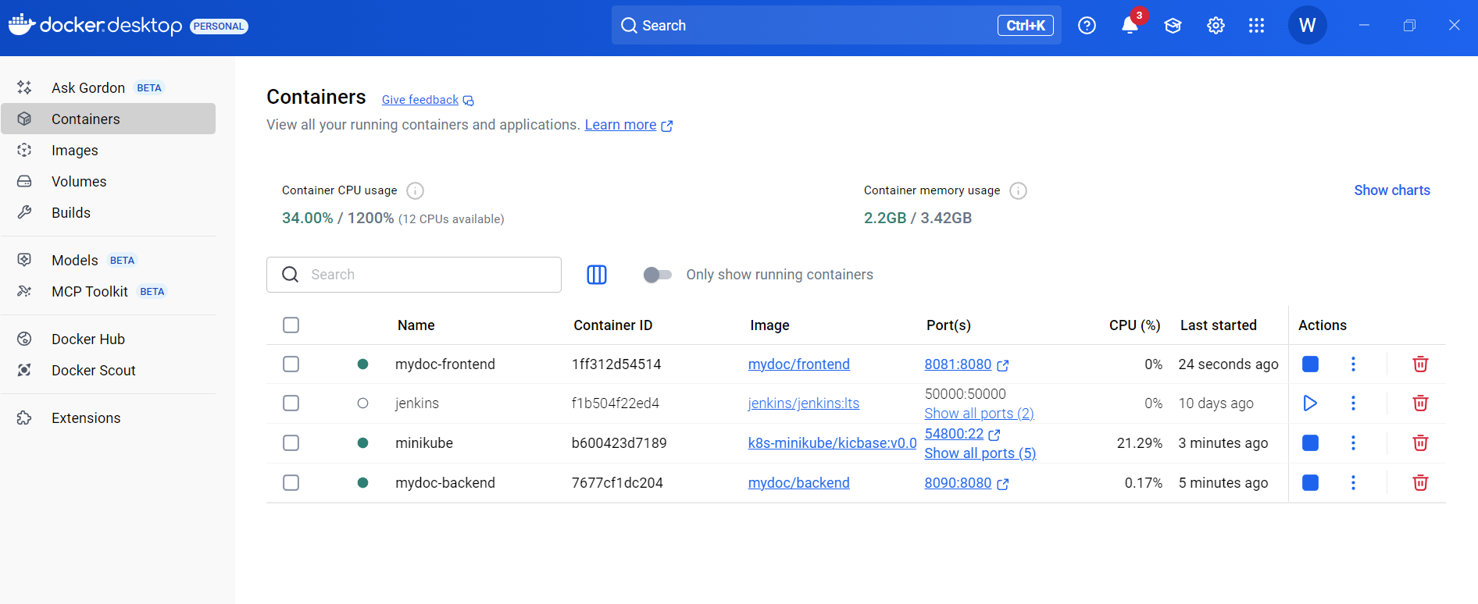
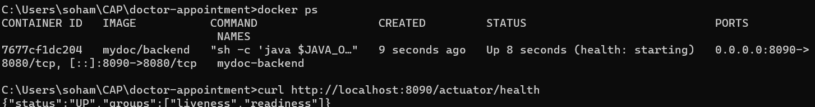
DOCKER
11
2025 - RPS Consulting all rights reserved

Slide 12
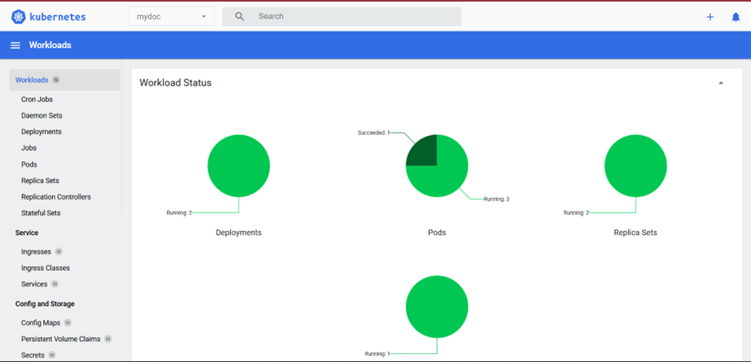
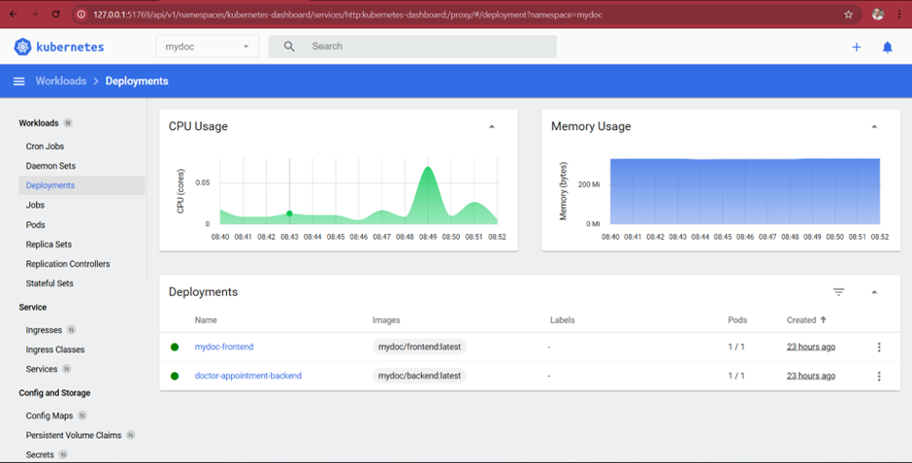
KUBERNETES
12
2025 - RPS Consulting all rights reserved

Slide 13
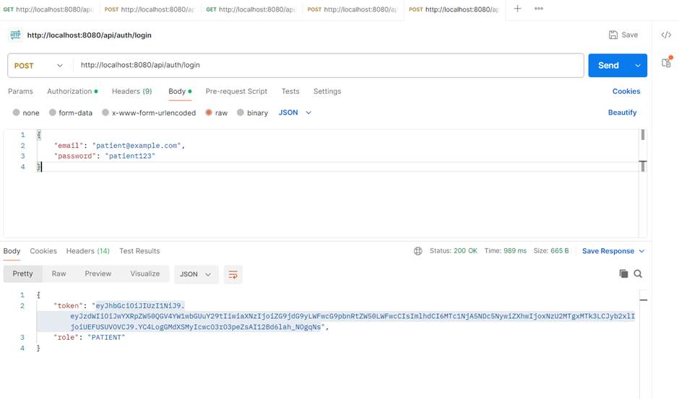
TESTING
13
2025 - RPS Consulting all rights reserved

Slide 14
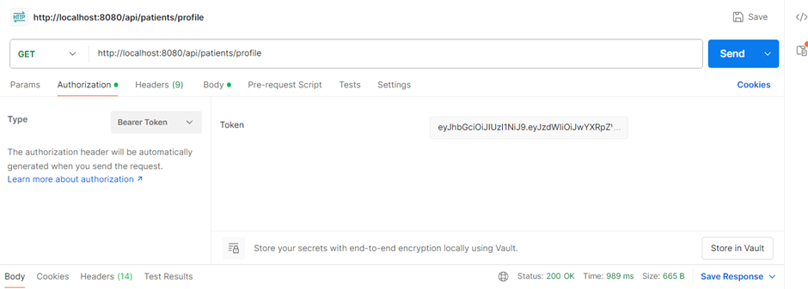
TESTING
14
2025 - RPS Consulting all rights reserved

Slide 15
THANK YOU
2025 - RPS Consulting all rights reserved

